Slide 1
Online Home services
SRP - PROJECT

Slide 2
Welcome to the newly designed project Home Service system , it is a faster service and it is one of the most personal website, specially designed to make your home services experience better.

Slide 3


Slide 4
Abstract
A System that provides variety of services like plumbers, movers and packers, repair persons, cleaners, electricians, painters, taxi service laundry and many more. To make it comfortable for all the users our system also provides a mobile environment which offers ease in accessing our services.
A very simple process is carried out to book a service, and our system is specialized with providing a confirmation email about the selected service.
People can choose the particularity of service required by uploading the image of desired specification. System is versatile as service can be booked from everywhere to anywhere you desire.

Slide 5
Objectives
The primary objective of the online system for household services is about delivering the home services at the door step just by one click. Online system for household services can be used by any authorized user intending to seek for household services through an ingenious web based system or a mobile application.
To provide an authenticated and authorized login module for the users such as service seekers, service providers and the admin, by providing appropriate credentials at the time of registration.
To develop a web based online system for opting household services for opting the services.
To design a interactive User Interface for seeking services on the go. To provide a secured online payment gateway for service seekers. To acknowledge the confirmation of services opted by the users.

Slide 6
System Requirements :
Software Requirements :
Server side | Software tools: HTML, CSS , BOOTSTRAP, PHP. Database: MySQL
Client side | Any Operating System that Supports Browser.

Slide 7
4)Design:
System Tools:
HTML : The Hyper Text Markup Language or HTML is the standard The Hyper Text Markup Language or HTML is the standard markup language for documents designed to be displayed in a web browser. It can be assisted by technologies such as cascading style sheets (CSS) and scripting languages such as java script. Web browsers receive HTML documents from a web server or from local storage and render the documents into multimedia web pages. HTML describes the structure of a web page symantically and originally included cues for the appearance of the document.
PHP : PHP is now one of the most widespread programming languages for building server-side web applications. PHP is server scripting language ,and a powerful tool for making dynamic and interactive web pages.

Slide 8
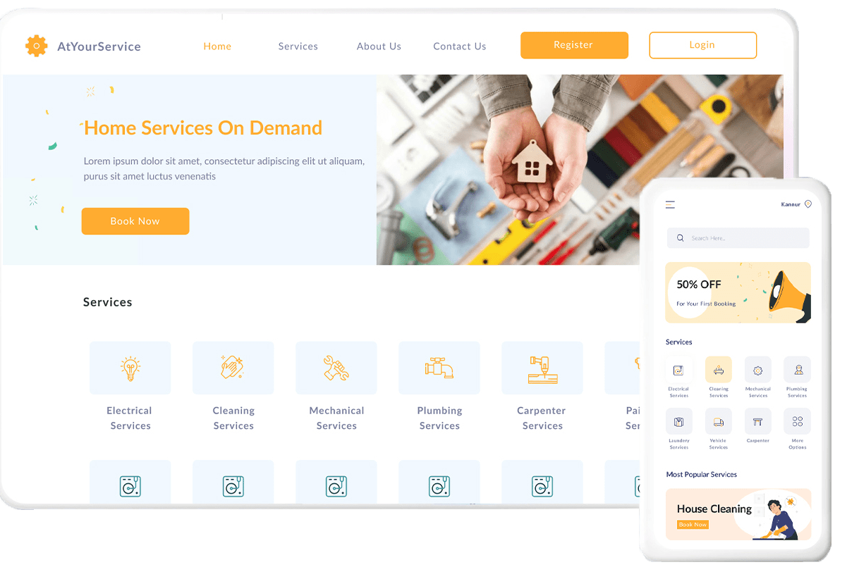

Slide 9
MySQL : MySQL is a widely used relational database management system (RDBMS).MySQL is free and open-source. MySQL is ideal for both small and large applications.it is used to store data into tables.
WordPress : WordPress The WordPress based on SQL as a backend where the admin stores all the credentials of the service seekers and service providers. the service seekers can opt for the required services from a highly interactive user Interface which is build using some of the scripting languages and WordPress. The WordPress provides a free payment gateway called Woo commerce. This Woo Commerce gateway plug-in is combined with a business account from Inspire Commerce, where it will allow you to accept transactions from all major credit cards such as Visa, MasterCard, American Express

Slide 10
4.2 System Modules:
4.2.1 Registration Module
Customers who want to avail our services are invited to register for a free account in our portal with few simple steps, by providing valid credentials a customer is requested to confirm account creation. Once they are done with registration, a confirmation mail about a new account with verification link is directed to the Email-id provided. Now a customer is free to use our services when they are done with account verification
4.2.2 Service Module
When customers want to schedule a service, they can do it by logging in to their account. The portal is specialized with an interactive user interface which provides attractive way of booking a service, where customers are requested to provide the details about the services required. If required customers are asked to upload the pictures of their particulars, if they are confused with any of the services. When done, the request is submitted and it is directed to payment page for the payments to be done.

Slide 11
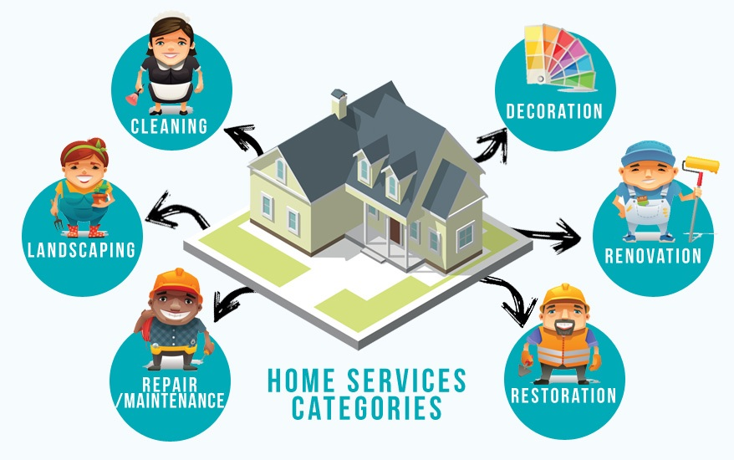

Slide 12
4.2.3 Payment Module
Further process is preceded to the next module where the customer needs to pay for the services opted. It is done through an external payment gateway which guarantees a secure and safe transaction. Once the payment is done, a confirmation acknowledgement is forwarded to the user about all the details of services opted and also an onsite confirmation is displayed on the website. When the service is booked and confirmed, service men from our organization will reach you to deliver the service

Slide 13
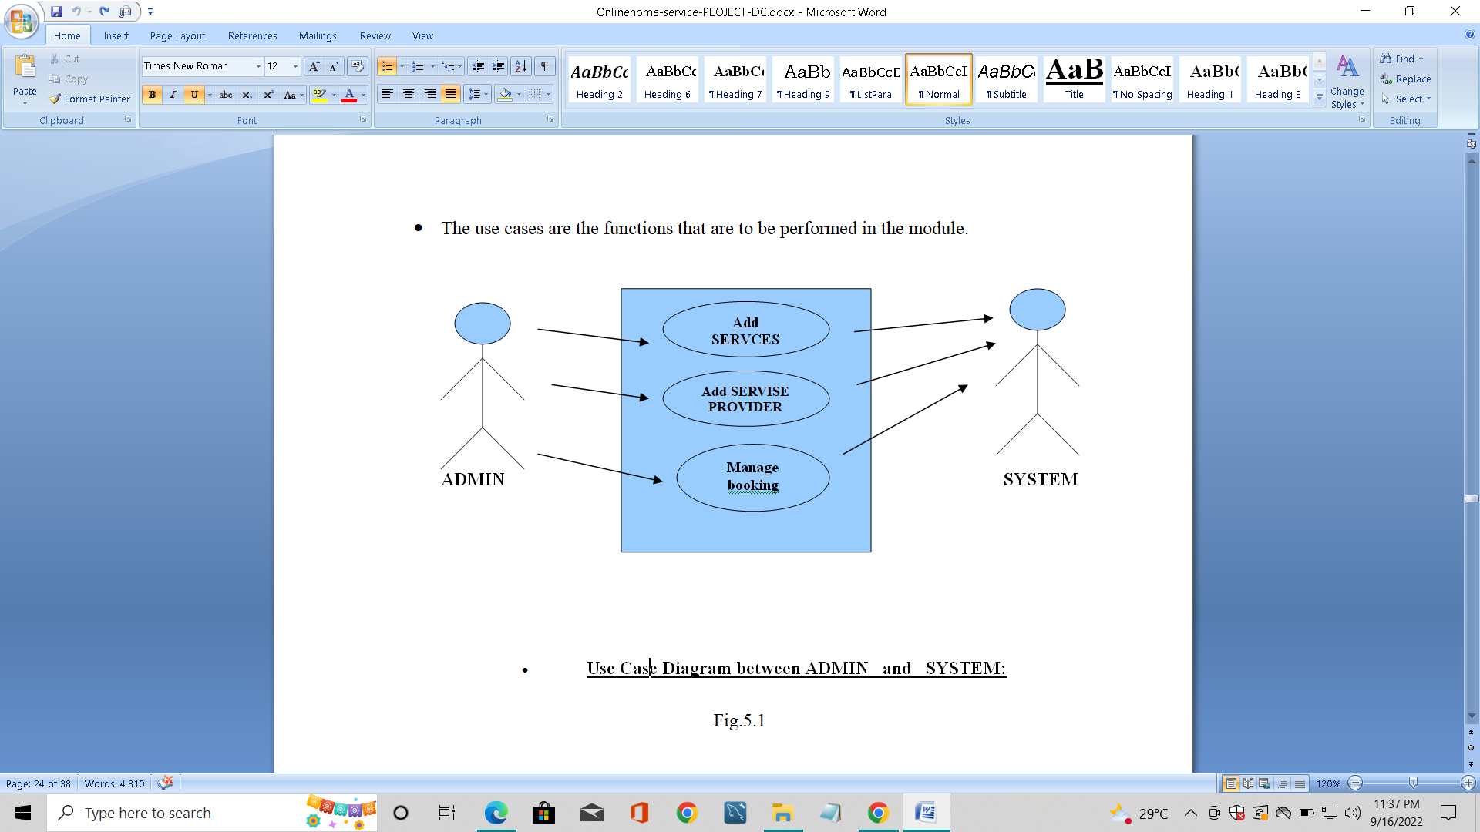
Diagram between ADMIN and SYSTEM :

Slide 14
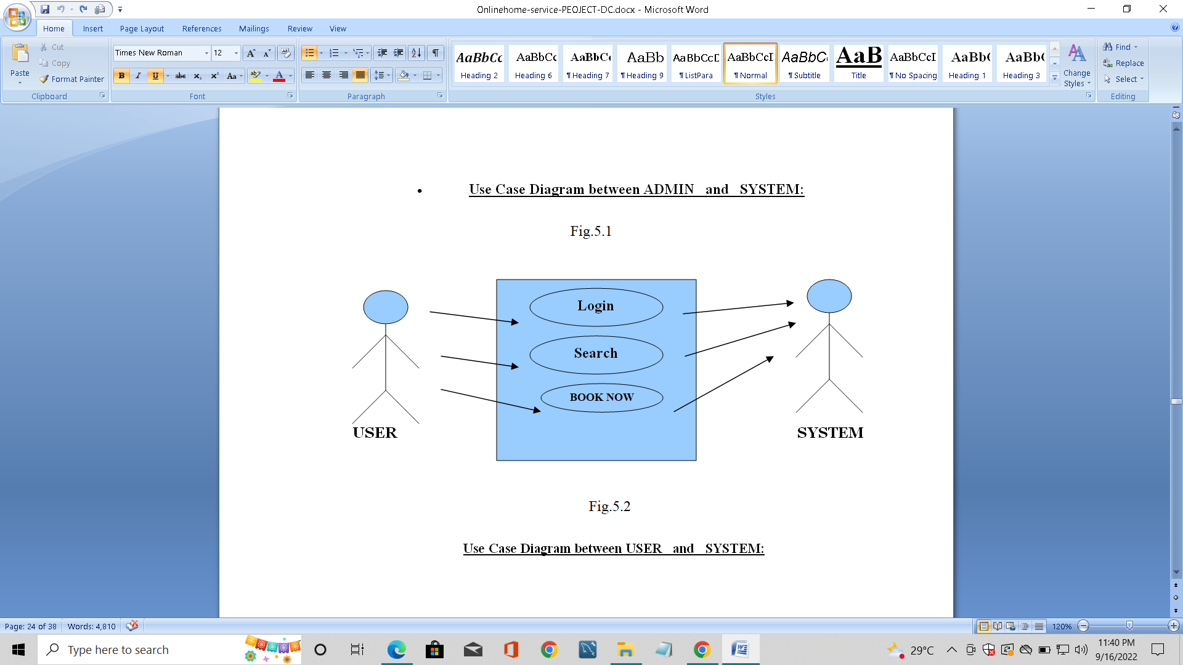
Diagram between USER and SYSTEM :

Slide 15
Conclusion :
To reduce burden in finding in-house solutions for the services, the proposed system provides several services by providing service specialists at your doorstep in one click. A systematic mobile environment to system clients offers ease in accessing our services in a more comfortable way. With well qualified and background demonstrated professionals we make all your home cleaning, plumbing, furniture maintenance, electrical works, appliance repair, house painting, vehicle service and many other services to be done in a click anytime from anywhere as easy as available.

Slide 16
THANK YOU ..
Done by :
G . BHAVANI (20331A0566)
M . TARUN KUMAR (20331A05B0)
K . RAVINDRA NAIDU (20331A0597)
G . LALITHA MAHESWARI (20331A0565)

